Slide 1
Architecture Design
Instructor: Mehroze Khan

Slide 2
The Design Process
Design is the creative process of figuring out how to implement all the customer’s requirements; the resulting plan is also called the design.
Early design decisions address the system’s architecture, explaining how to:
Decompose the system into units
How the units relate to one another
Describe any externally visible properties of the units
Later design decisions address how to implement the individual units.

Slide 3
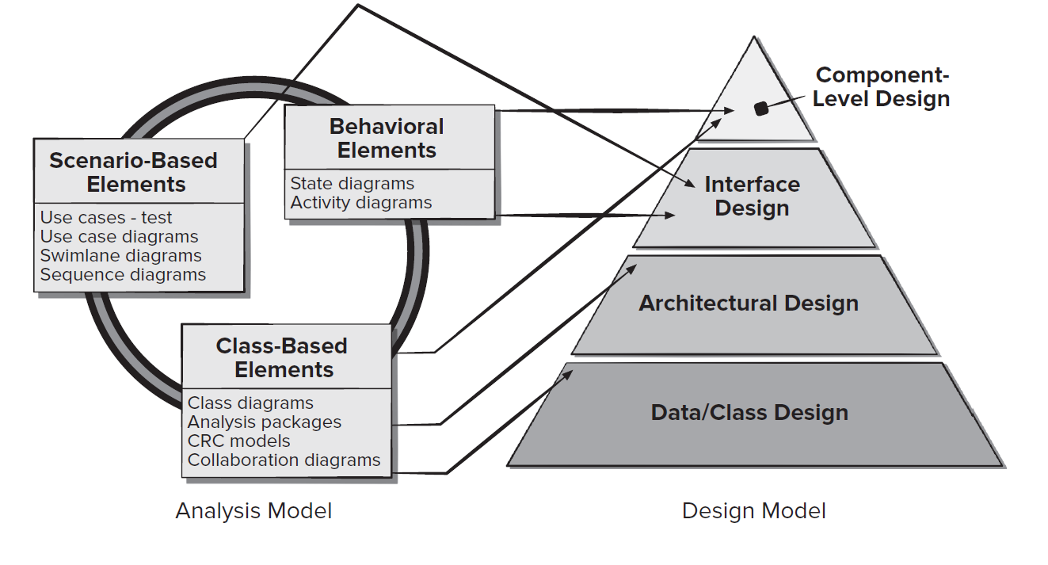
Translating Requirements to Design

Slide 4
Requirements and Design
To see how architecture relates to both design and requirements, consider the example to build a new house.
The requirements include:
Rooms for parents and three children
A place for the children to play
A kitchen and a large dining room that will hold an extendable table
Storage for bicycles, lawn mower, ladder, barbecue.
Heating and air conditioning

Slide 5
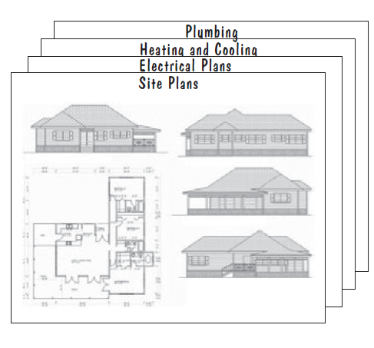
Architectural Plans

Slide 6
Multiple Designs
Maximize playing area
Minimize playing area
Large bedrooms
Two story house
Single story house
Which is the best design?
Will a proposed solution result in modified requirements?

Slide 7
The Design Process Design is a Creative Process
Design is an intellectually challenging task
Numerous possibilities the system must accommodate
Non-functional design goals (e.g., ease of use, ease to maintain)
External factors (e.g., standard data formats, government regulations)
We can improve our design by studying examples of good design
Most design work is routine design, solve problem by reusing and adapting solutions from similar problems

Slide 8
The Design Process Design is a Creative Process
Using already available designs and solutions provides:
Efficiency (in quickly settling on a plan)
Predictability (in knowing that the resulting product should be similar in quality to existing one)

Slide 9
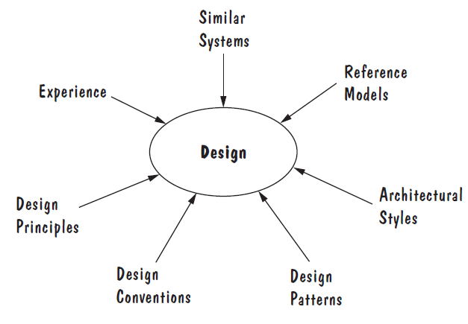
The Design Process Design is a Creative Process
Sources of Design Advise

Slide 10
The Design Process Design is a Creative Process
Ways to Leverage Existing Solutions:
Cloning: Borrow a whole design/code, make minor adjustments to fit the problem.
Reference Model: A standard generic architecture that suggests how to decompose a system into its major components and how those components interact with each other.
Software architectures have generic solutions too, called architectural styles.
Focusing on one architectural style can create problems
Good software architectural design is about selecting, adapting, and integrating several architectural styles in ways that best produce the desired result.
Notes:
Like reference models, architectural styles give advice about how to decompose a problem into software units and how those units should interact with each other.
Unlike reference models, architectural styles are not optimized for specific application domains. Rather, they give generic advice about how to approach generic design problems

Slide 11
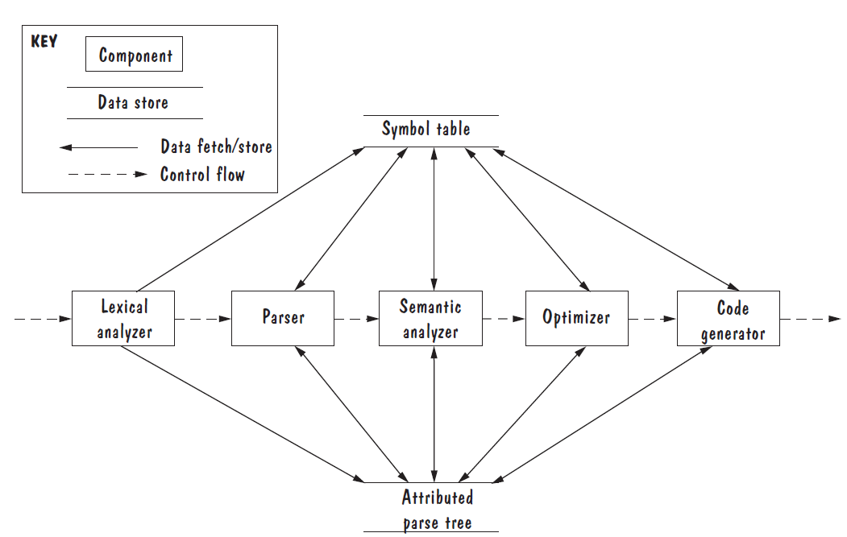
Reference Model of a Compiler

Slide 12
The Design Process Design is a Creative Process
Ways to Leverage Existing Solutions(Continued):
Design patterns are generic solutions for making lower-level design decisions about individual software modules or small collections of modules.
A design convention or idiom is a collection of design decisions and advice that, taken together, promotes certain design qualities.
The guidance we can use in innovative design is a set of basic design principles that are descriptive characteristics of good design, rather than prescriptive advice about how to design.
Notes:
Design Convention example, abstract data types (ADTs) are a design convention that encapsulates data representation and supports reusability
Sometimes, existing solutions cannot solve a problem satisfactorily; we need a novel solution that requires innovative design. In contrast to routine design, the innovative design process is characterized by irregular bursts of progress that occur as we have flashes of insight.

Slide 13
Design Process Model Design is an Iterative Process
During the first part of the design phase, we iterate among three activities:
Drawing architectural plans
Analyzing how well the proposed architecture promotes desired properties
Using the analysis results to improve and optimize the architectural plans
At the architectural stage, we focus on system-level decisions
Communication
Coordination
Synchronization
Sharing
As the architecture starts to stabilize
Document models.
Each of the models is an architectural view, and the views are interconnected
A change to one view may have an impact on other views.

Slide 14
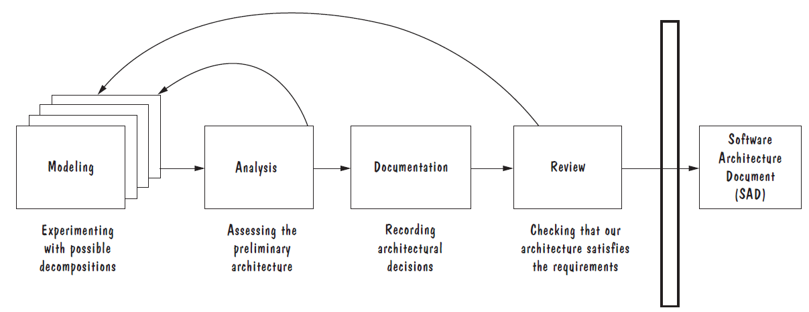
Design Process Model Design is an Iterative Process
Once the architecture is documented
Conduct a formal design review, in which the project team checks that the architecture meets all the system’s requirements and is of high quality.
If problems are identified during the design review, we may have to revise our design yet again to address these concerns.
The outcome of the software architecture process is the SAD, used to communicate system-level design decisions to the rest of the development team.

Slide 15
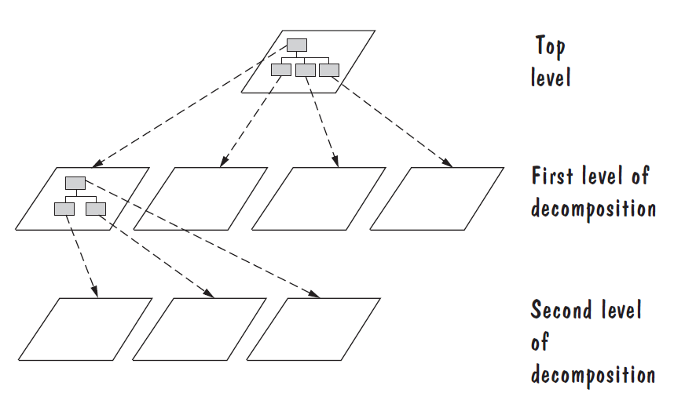
Decomposition and Views
Design by decomposition starts with a high-level description of the system’s key elements.
Iteratively refine the design by dividing system’s elements into its constituent pieces and describing their interfaces.

Slide 16
Design Methods
Some popular design methods:
Functional decomposition
Feature-oriented decomposition
Data-oriented decomposition
Process-oriented decomposition
Event-oriented decomposition
Object-oriented design

Slide 17
Design Methods
Functional decomposition:
Partitions functions or requirements into modules.
Lower-level designs divide these functions into subfunctions, which are then assigned to smaller modules.
The design also describes which modules (subfunctions) call each other.

Slide 18
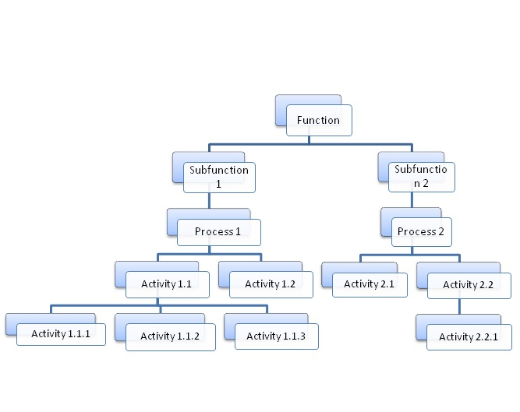
Functional Decomposition

Slide 19
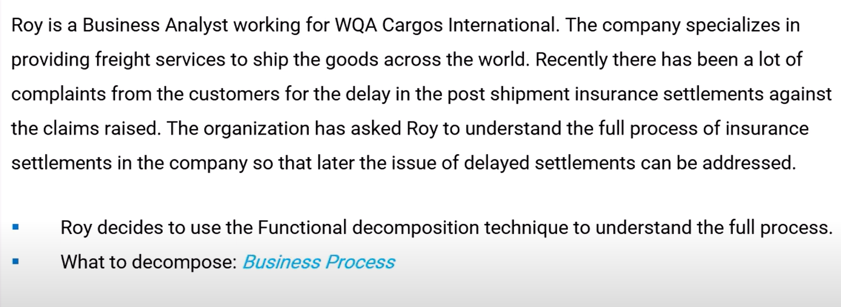
Functional Decomposition Example
https://www.youtube.com/watch?v=AovfJJRZ1EA&ab_channel=Techcanvass

Slide 20
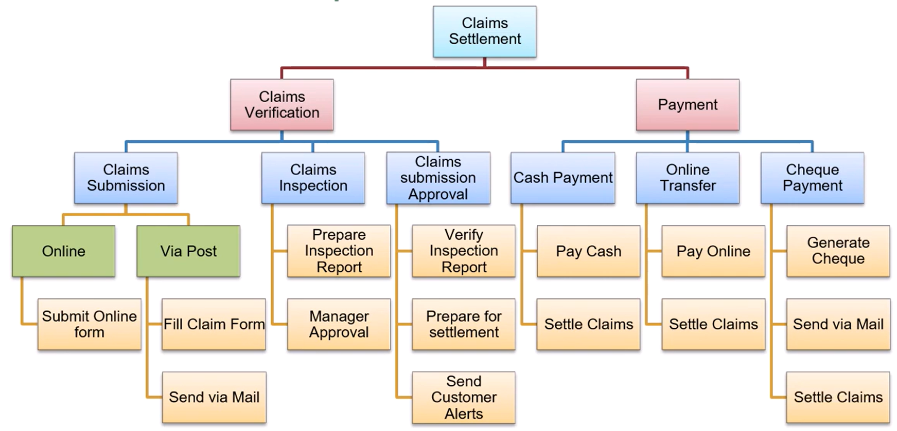
Functional Decomposition Example

Slide 21
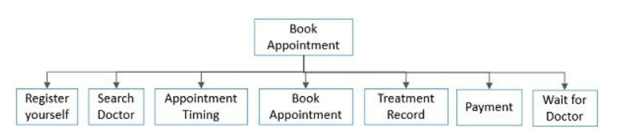
Functional Decomposition Example
Suppose that you need to design software that can be used by the patients to make an appointment with the doctor.

Slide 22
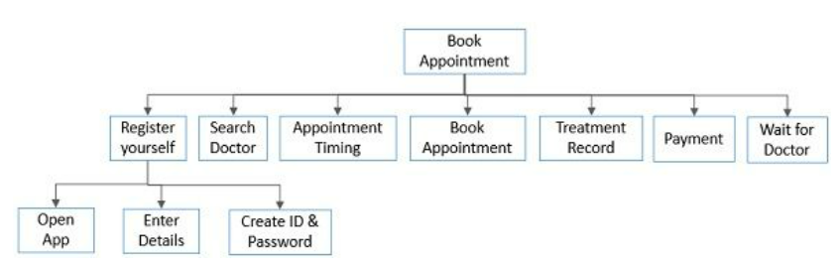
Functional Decomposition Example

Slide 23
Functional Decomposition Example
Student Registration System
Data Entry Validation
Transaction Verification
Report Generation
Data Updation
Student Data Validation
Course Data Validation
Transaction Checks
Addition Modules
Deletion Module

Slide 24
Design Methods
Feature-oriented design:
Assigns features to modules.
High-level design describes the system in terms of a service and a collection of features.
Lower-level designs describe how each feature augments the service and identifies interactions among features.
Data-oriented decomposition:
Focuses on how data will be partitioned into modules.
High-level design describes conceptual data structures
Lower-level designs provide detail as to how data are distributed among modules and how the distributed data realize the conceptual models.

Slide 25
Design Methods
Process-oriented decomposition:
Partitions the system into concurrent processes.
High-level design
Identifies the system’s main tasks
Assigns tasks to runtime processes
Explains how the tasks coordinate with each other.
Lower-level designs describe the processes in more detail.
Event-oriented decomposition:
Focuses on the events that the system must handle and assigns responsibility for events to different modules.
High-level design catalogues the system’s expected input events.
Lower-level designs decompose the system into states and describe how events trigger state transformations.

Slide 26
Design Methods
Object-oriented design:
Assigns objects to modules.
High-level design identifies the system’s object types and explains how objects are related to one another.
Lower-level designs detail the objects’ attributes and operations.

Slide 27
Decomposition and Views
A design is modular when each activity of the system is performed by exactly one software unit, and when the inputs and outputs of each software unit are well-defined
A software unit is well-defined if its interface accurately and precisely specifies the unit’s externally visible behaviour
Modularity is the most common manifestation of separation of concerns. Software is divided into separately named and addressable components, sometimes called modules, that are integrated to satisfy problem requirements.

Slide 28
Architectural Styles
Software architectural styles are established, large-scale patterns of system structure.
They have defining rules, elements, and techniques that result in designs with recognizable structures and well understood properties.
Not complete detailed solutions. Rather, they are loose templates that offer distinct solutions for coordinating a system’s components.
Focus on the different ways that components might communicate, synchronize, or share data with one another.

Slide 29
Architectural Styles
Pipe-Filter
Client-Server
Peer-to-Peer
Publish-Subscribe
Repositories
Layering
Call-Return

Slide 30
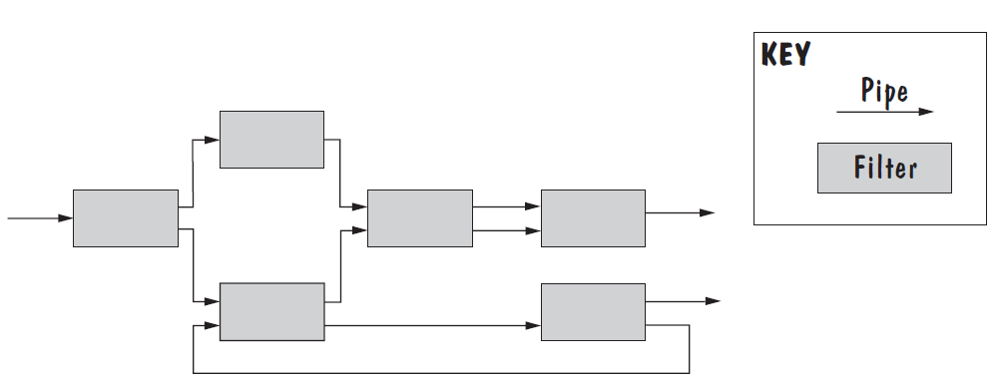
Pipe and Filter
System functionality is achieved by passing input data through a sequence of data-transforming components, called filters, to produce output data.
Pipes are connectors that simply transmit data from one filter to the next without modifying the data.

Slide 31
Pipe and Filter
Several important properties
The designer can understand the entire system's effect on input and output as the composition of the filters
The filters can be reused easily on other systems
System evolution is simple
Allow concurrent execution of filters
Drawbacks
To support a fixed data format during data transmission, each filter must parse input data before performing its computation and then convert its results back to the fixed data format for output. This repeated parsing and unparsing of data can hamper system performance.
Not good for handling interactive application

Slide 32
Client Server
Two types of components:
Server components offer services
Clients access them using a request/reply protocol.
The components execute concurrently and are usually distributed across several computers.
There may be one centralized server, several replicated servers distributed over several machines, or several distinct servers each offering a different set of services.
The relationship between clients and servers is asymmetric: Clients know the identities of the servers from which they request information, but servers know nothing about which, or even how many, clients they serve.

Slide 33
Client Server
Clients initiate communications by issuing a request, as a message or a remote-procedure call
Servers respond by fulfilling the request and replying with a result.
Normally, servers are passive components that simply react to clients’ requests, but in some cases, a server may initiate actions on behalf of its clients.
For example, a client may send the server an executable function, called a callback, which the server subsequently calls under specific circumstances.

Slide 34
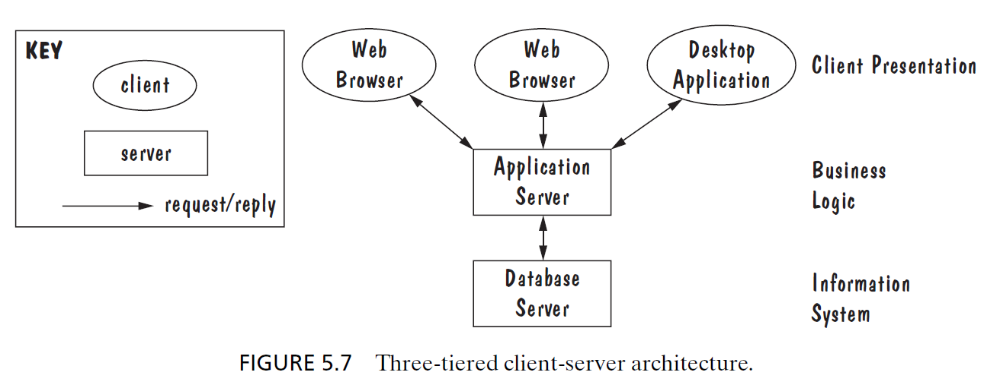
Client Server

Slide 35
Peer-to-Peer
A peer-to-peer (P2P) architecture is one in which each component executes as its own process and acts as both a client of and a server to other peer components.
Each component has an interface that specifies not only the services it provides, but also the services that it requests from other peer components.
Peers communicate by requesting services from each other.
Any component can initiate a request to any other peer component.
What differs among components are the data each component stores locally.
System’s data are distributed among the components; whenever a component needs information not stored locally, it retrieves it from a peer component.

Slide 36
Peer-to-Peer
The best-known P2P architectures are file-sharing networks, such as Napster and Freenet, in which the components provide similar services to each other.
P2P Networks Advantages:
They scale up well.
Each added component increases the system’s capabilities, in the form of new or replicated data and as additional server capacity.
Highly tolerant of network failures, because data are replicated and distributed over multiple peers.
P2P Networks Disadvantage:
Each added component increases demands on the system in the form of additional requests.

Slide 37
Peer-to-Peer
When NOT to use:
When file contents change frequently (e.g. prices)
When sharing speed has importance (e.g. large files are needed quickly)
File quality is critical
When trust between peers is required (e.g. the content is protected)

Slide 38
Publish-Subscribe
In a publish-subscribe architecture, components interact by broadcasting and reacting to events.
Component expresses interest in an event by subscribing to it.
When another component announces (publishes) that the event has taken place, the subscribing components are notified.
Implicit invocation is a common form of publish-subscribe architecture, in which a subscribing component associates one of its procedures with each event of interest (called registering the procedure).
When the event occurs, the publish-subscribe infrastructure invokes all the event’s registered procedures.
In contrast to client-server and P2P components, publish-subscribe components know nothing about each other.

Slide 39
Publish-Subscribe
Publishing component simply announces events and then waits for interested components to react; each subscribing component simply reacts to event announcements, regardless of how they are published.
For Example, tools such as editors register for events that might occur during a debugger’s functioning.
Consider that the debugger processes code, one line at a time.
When it recognizes that it has reached a set breakpoint, it announces the event “reached breakpoint”
Then, the system forwards the event to all registered tools, including the editor
Editor reacts to the event by automatically scrolling to the source-code line that corresponds to the breakpoint.

Slide 40
Publish-Subscribe
Strengths:
Provide strong support for system evolution and customization.
Any component can be added to the system and can register itself without affecting other components.
Can easily reuse publish-subscribe components in other event-driven systems.
Weaknesses:
Components can pass data at the time they announce events. But if components need to share persistent data, the system must include a shared repository to support that interaction. This sharing can diminish the system’s extensibility and reusability.
Difficult to test, because the behavior of a publishing component will depend on which subscribing components are monitoring its events. Thus, we cannot test the component in isolation and infer its correctness in an integrated system.

Slide 41
Repositories
A repository style of architecture consists of two types of components:
Central data store
Associated data-accessing components.
Shared data are stockpiled in the data store.
Data accessors are computational units that store, retrieve, and update the information.
In the blackboard type of repository, the data accessing components are reactive: they execute in reaction to the current contents of the data store.
Blackboard contains information about the current state of the system’s execution that triggers the execution of individual data accessors, called knowledge sources.
For example, the blackboard may store computation tasks, and an idle knowledge source checks a task out of the blackboard, performs the computation locally, and checks the result back into the blackboard.

Slide 42
Repositories
For example, in a rule-based system, the current state of the solution is stored in the blackboard, and knowledge sources iteratively revise and improve the solution by applying rewriting rules.
An important property of this style of architecture is the centralized management of the system’s key data.
In the data store, we can
Localize responsibility for storing persistent data
Managing concurrent access to the data
Enforcing security and privacy policies, and protecting the data against faults (e.g., via backups).

Slide 43
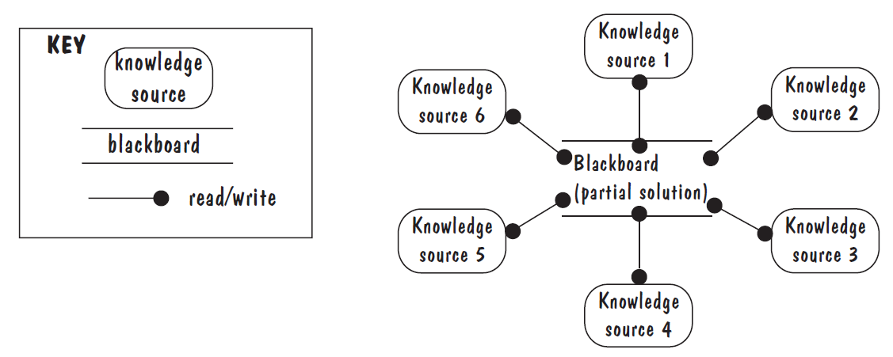
Blackboard

Slide 44
Layering
Layers are hierarchical
Each layer provides service to the one outside it and acts as a client to the layer inside it
Layer bridging: allowing a layer to access the services of layers below its lower neighbor
The design includes protocols
Explain how each pair of layers will interact
Under no circumstances does a layer access the services offered by a higher-level layer; the resulting architecture would no longer be called layered.

Slide 45
Layering
Strengths:
The layering style is useful whenever we can decompose our system’s functionality into steps, each of which builds on previous steps.
Layer modification is relatively easy; such changes should affect at most only the two adjacent layers.
Weaknesses:
It is not always easy to structure a system into distinct layers of increasingly powerful services, especially when software units are seemingly interdependent.
It may appear that layers introduce a performance cost from the set of calls and data transfers between system layers.

Slide 46
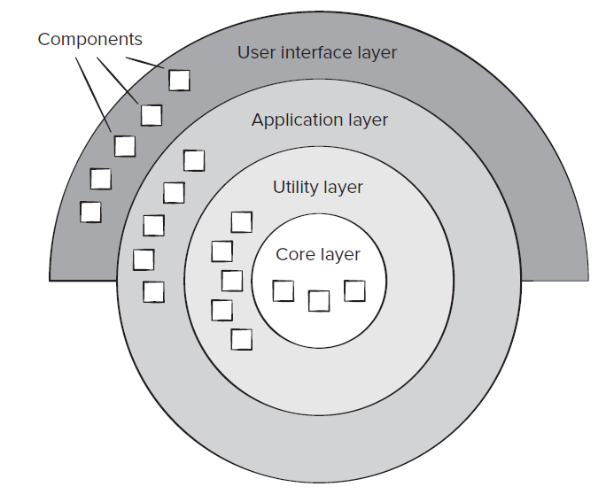
Layering

Slide 47
Call-and-Return
Enables you to achieve a program structure that is relatively easy to modify and scale.
Two substyles that exist within this category:
Main program/subprogram architectures. This classic program structure decomposes function into a control hierarchy where a “main” program invokes several program components, which in turn may invoke still other components.
Remote procedure call architectures. The components of a main program/subprogram architecture are distributed across multiple computers on a network.

Slide 48
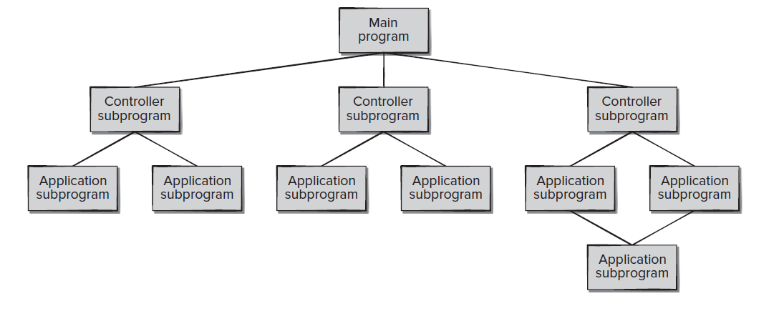
Call-and-Return

Slide 49
Combining Architectural Style
Actual software architectures rarely based on purely one style
Architectural styles can be combined in several ways
Use different styles at different layers (e.g., overall client-server architecture with server component decomposed into layers)
Use mixture of styles to model different components or types of interaction (e.g., client components interact with one another using publish-subscribe communications
If architecture is expressed as collection of models, documentation must be created to show relation between models
Integration of different architectural styles is easier if the styles are compatible

Slide 50
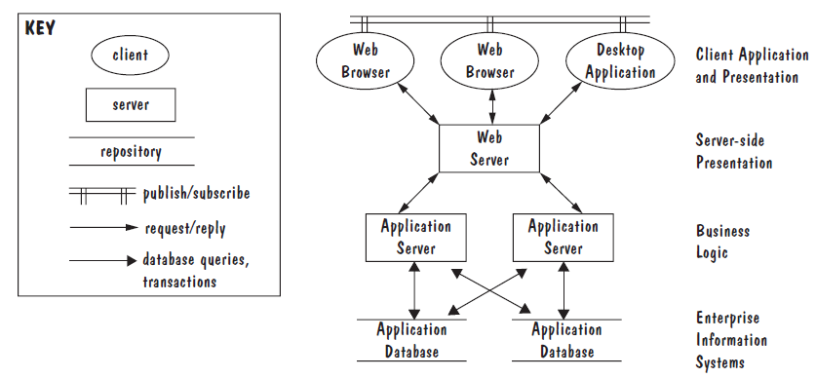
Combining Architectural Style
Combination of Publish-Subscribe, Client-Server and Repository Architectural Style
Notes:
In this example, several client components interact with each other using publish-subscribe communications. These same components use server components via request/reply protocols; in turn, the server components interact with a shared data repository. In this example, the architecture integrates different styles into a single model by allowing components to play multiple roles (e.g., client, publisher, and subscriber) and to engage in multiple types of interactions.

